Slide 1
Week 5
An Introduction to Cyber Security – CS 573
Instructor: Dr. Edward G. Amoroso
eamoroso@tag-cyber.com

Slide 2
Week 5
Required Week Five Readings
“Password Authentication with Insecure Communication,” Leslie Lamport
https://lamport.azurewebsites.net/pubs/password.pdf
2. Chapters 12 through 16: From CIA to APT: An Introduction
to Cyber Security, E. Amoroso & M. Amoroso
Twitter: @hashtag_cyber
LinkedIn: Edward Amoroso

Slide 3

Week 5
Required Additional Reading: https://www.tag-cyber.com/advisory/annuals

Slide 4
Week 5
Week 5: Authentication Protocols

Slide 5
Case Study: Brute Force Cryptanalytic Attack
Week 5
Classic Caesar Cipher
(Shift +2 in Alphabet)
Plaintext:
Loren ipsum is a pseudo Latin
text used in typography
Ciphertext:
Nqtgp kruwo ku c rugwfq Ncvjp
Vgzv wugf kp varqitcrjb

Slide 6
Case Study: Brute Force Cryptanalytic Attack
Week 5
Classic Caesar Cipher
(Shift +2 in Alphabet)
Plaintext:
Loren ipsum is a pseudo Latin
text used in typography
Ciphertext:
Nqtgp kruwo ku c rugwfq Ncvjp
Vgzv wugf kp varqitcrjb
Plain Text Character Distribution:
(Approximates Frequency Distribution of English Language with More Data)
4
3
2
1
a b c d e f g h i j k l m n o p q r s t u v w x y z

Slide 7
Case Study: Brute Force Cryptanalytic Attack
Week 5
Classic Caesar Cipher
(Shift +2 in Alphabet)
Plaintext:
Loren ipsum is a pseudo Latin
text used in typography
Ciphertext:
Nqtgp kruwo ku c rugwfq Ncvjp
Vgzv wugf kp varqitcrjb
Plain Text Character Distribution:
(Approximates Frequency Distribution of English Language with More Data)
4
3
2
1
a b c d e f g h i j k l m n o p q r s t u v w x y z
Ciphertext Character Distribution:
(Frequency Distribution Exposes Caesar Cipher Character Mapping)
4
3
2
1
c d e f g h i j k l m n o p q r s t u v w x y z a b

Slide 8
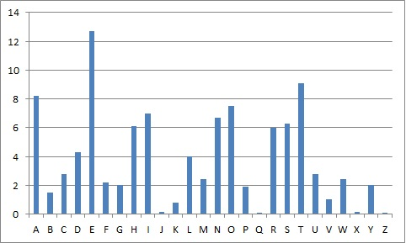
Case Study: Brute Force Cryptanalytic Attack
Week 5
Actual
Frequency
Distribution
4
3
2
1
c d e f g h i j k l m n o p q r s t u v w x y z a b

Slide 9
Safeguard: Authentication
Week 5
Asset
Adversary
Report Identity
Identity
Management
Policy-Based
Prioritization
Authentication:
Identity Validation
Access Management:
Policy-Based Privilege
Identity and Access Management Infrastructure

Slide 10
Authentication Schema
Week 5
Step 1: Identification “I am Alice.”
A
B
Client A – Server B: “Client Authentication”
Client B – Server A: “Server Authentication”

Slide 11
Authentication Schema
Week 5
Step 1: Identification “I am Alice.”
A
Step 2: Challenge “Prove it, please.”
B
Challenge includes tangible domain value – possible “known plaintext” attacks
Challenge includes no tangible domain value – likely to restrict to “ciphertext attacks”

Slide 12
Authentication Schema
Week 5
Step 1: Identification “I am Alice.”
Step 3:
Computation
“Get Proof”
Step 2: Challenge “Prove it, please.”
A
B
Computation might involve simple look-up/locate process (e.g., passwords)
Computation might be more deliberate mathematical operation on domain value

Slide 13
Authentication Schema
Week 5
Step 1: Identification “I am Alice.”
Step 3:
Computation
“Get Proof”
Step 2: Challenge “Prove it, please.”
A
B
Step 4: Response “Here is proof.”
Types of Proof:
“Something You Know” – Passwords
“Something You Are” – Biometrics
“Something You Have” – Token
“Somewhere You Are” – Location
- Adaptive Authentication
considers context
- Two-Factor Authentication
uses at least two types

Slide 14
Authentication Schema
Week 5
Step 1: Identification “I am Alice.”
Step 3:
Computation
“Get Proof”
Step 2: Challenge “Prove it, please.”
Step 5:
Validation
“Check Proof”
A
B
Step 4: Response “Here is proof.”
Validation might involve simple look-up/locate process (e.g., passwords)
Validation might be more deliberate mathematical operation on domain value

Slide 15
Authentication Schema
Week 5
Step 1: Identification “I am Alice.”
Step 3:
Computation
“Get Proof”
Step 2: Challenge “Prove it, please.”
Step 5:
Validation
“Check Proof”
A
B
Step 4: Response “Here is proof.”
Step 6: Notification “Hello, Alice.”

Slide 16
Authentication Schema
Week 5
Zone 1: Client
Zone 2: Network
Zone 3: Server
Step 1: Identification “I am Alice.”
Step 3:
Computation
“Get Proof”
Step 2: Challenge “Prove it, please.”
Step 5:
Validation
“Check Proof”
A
B
Step 4: Response “Here is proof.”
Step 6: Notification “Hello, Alice.”
Network
Attacks
Client
Attacks
Server
Attacks
E
Eve is the
Attacker

Slide 17
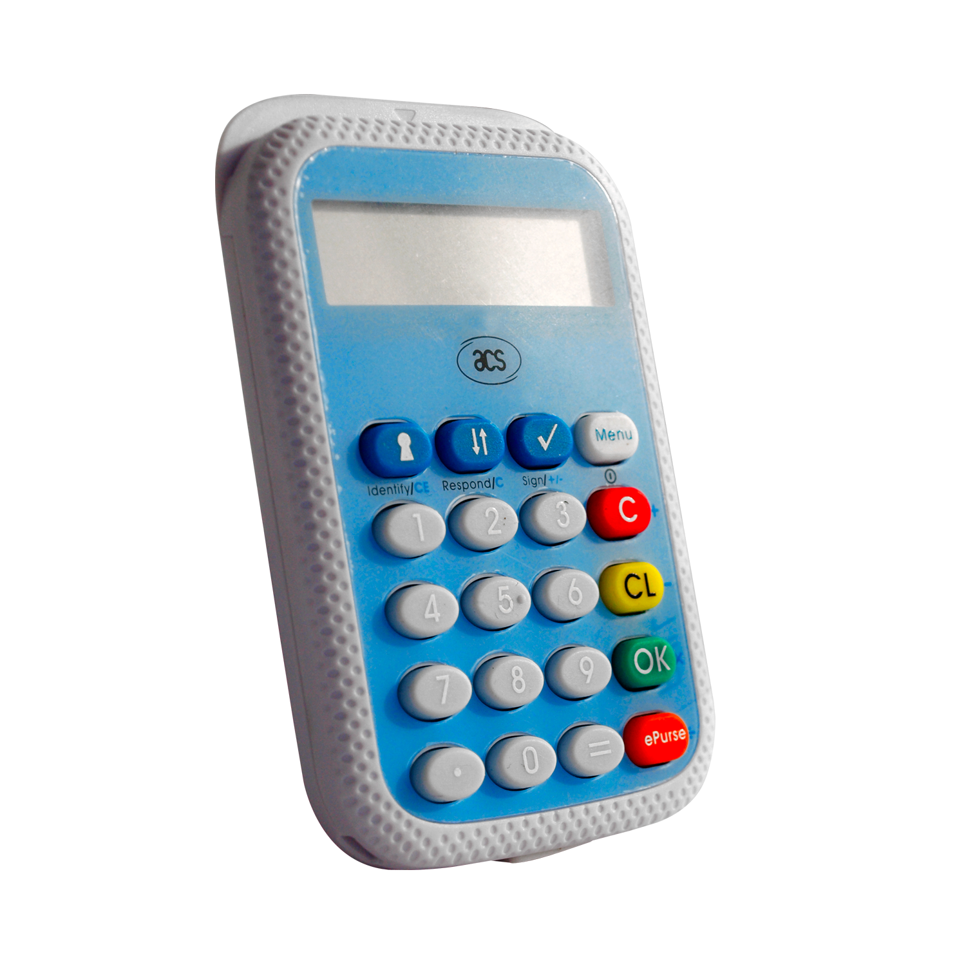
Handheld Authentication Device
Week 5
A
B
User
Function
A
f
C
f ’
Embedded Function
f: integer -> integer
G
f ’’
. . .
. . .

Slide 18
Handheld Authentication Device
Week 5
Protocol
Implementation
A
B
User
Function
Protocol
Infrastructure
A
f
C
f ’
Embedded Function
f: integer -> integer
G
f ’’
. . .
. . .

Slide 19
Handheld Authentication Device
Week 5
Step 1: I am Alice
A
B
User
Function
A
f
C
f ’
Embedded Function
f: integer -> integer
G
f ’’
. . .
. . .

Slide 20
Handheld Authentication Device
Week 5
Step 1: I am Alice
Step 2: λ = 237
A
B
Randomly selected
integer λ
User
Function
A
f
C
f ’
Embedded Function
f: integer -> integer
G
f ’’
. . .
. . .

Slide 21
Handheld Authentication Device
Week 5
Step 1: I am Alice
Step 3:
f(λ) = 881
Step 2: λ = 237
A
B
User
Function
A
f
C
f ’
Embedded Function
f: integer -> integer
G
f ’’
. . .
. . .

Slide 22
Handheld Authentication Device
Week 5
Step 1: I am Alice
Step 3:
f(λ) = 881
Step 2: λ = 237
A
B
Step 4: f(λ) = 881
User
Function
A
f
C
f ’
Embedded Function
f: integer -> integer
G
f ’’
. . .
. . .

Slide 23
Handheld Authentication Device
Week 5
Step 1: I am Alice
Step 3:
f(λ) = 881
Step 2: λ = 237
Step 5:
Compute
f(λ) = 881
locally
A
B
Step 4: f(λ) = 881
User
Function
A
f
C
f ’
Embedded Function
f: integer -> integer
G
f ’’
. . .
. . .

Slide 24
Handheld Authentication Device
Week 5
Step 1: I am Alice
Step 3:
f(λ) = 881
Step 2: λ = 237
Step 5:
Compute
f(λ) = 881
locally
A
B
Step 4: f(λ) = 881
Step 6: Hello, Alice
User
Function
A
f
C
f ’
Embedded Function
f: integer -> integer
G
f ’’
. . .
. . .

Slide 25
Handheld Authentication Device Protocol
Week 5
Zone 1: Client
Zone 2: Network
Zone 3: Server
Step 1: I am Alice
Step 3:
f(λ) = 881
Step 2: λ = 237
Step 5:
Compute
f(λ) = 881
locally
A
B
Step 4: f(λ) = 881
Step 6: Hello, Alice
Known Plaintext
Cryptanalytic
Attack
Round 1: λ = 237, f(λ) = 881
Round 2: λ’ = 801, f(λ’) = 7421
Round 3: λ’’ = 9906, f(λ’’) = 588
. . .
E
Eve

Slide 26
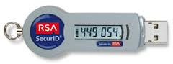
RSA SecurID One-Time Password (OTP) Algorithm
Week 5
f: integer -> integer
λ: integer seed
t₀: initial time
t_{C}: current time
Δt: time interval
n = (t_{C} – t₀) / Δt

Slide 27
RSA SecurID One-Time Password (OTP) Algorithm
Week 5
Unique seed
for each user
f: integer -> integer
λ: integer seed
t₀: initial time
t_{C}: current time
Δt: time interval
n = (t_{C} – t₀) / Δt
seed = λ
t₀ = 0 sec
n = 0
t_{C} = 0 sec

Slide 28
RSA SecurID One-Time Password (OTP) Algorithm
Week 5
Unique seed
for each user
Encrypt seed
once using f
f: integer -> integer
λ: integer seed
t₀: initial time
t_{C}: current time
Δt: time interval
n = (t_{C} – t₀) / Δt
seed = λ
OTP = f¹(λ)
t₀ = 0 sec
t₁ = 15 sec
n = 0
n = 1
t_{C} = 15 sec
Δt = 15 sec

Slide 29
RSA SecurID One-Time Password (OTP) Algorithm
Week 5
Unique seed
for each user
Encrypt seed
once using f
Encrypt seed
twice using f
f: integer -> integer
λ: integer seed
t₀: initial time
t_{C}: current time
Δt: time interval
n = (t_{C} – t₀) / Δt
seed = λ
OTP = f¹(λ)
OTP = f²(λ)
t₀ = 0 sec
t₁ = 15 sec
t₂ = 30 sec
n = 0
n = 1
n = 2
t_{C} = 30 sec
Δt = 15 sec

Slide 30
RSA SecurID Protocol
Week 5
Step 1: I am Alice
A
B
User
Information
f: integer -> integer
λ: integer seed
t₀: initial time
t_{C}: current time
Δt: time interval
n = (t_{C} – t₀) / Δt
A
f: integer -> integer
λ: integer seed
t₀: initial time
t_{C}: current time
Δt: time interval
n = (t_{C} – t₀) / Δt

Slide 31
RSA SecurID Protocol
Week 5
Step 1: I am Alice
A
Step 2: Prove it
B
User
Information
f: integer -> integer
λ: integer seed
t₀: initial time
t_{C}: current time
Δt: time interval
n = (t_{C} – t₀) / Δt
A
f: integer -> integer
λ: integer seed
t₀: initial time
t_{C}: current time
Δt: time interval
n = (t_{C} – t₀) / Δt

Slide 32
RSA SecurID Protocol
Week 5
Step 1: I am Alice
Step 3:
Read value
f^{n}(λ) = x
on token
A
Step 2: Prove it
B
User
Information
f: integer -> integer
λ: integer seed
t₀: initial time
t_{C}: current time
Δt: time interval
n = (t_{C} – t₀) / Δt
A
f: integer -> integer
λ: integer seed
t₀: initial time
t_{C}: current time
Δt: time interval
n = (t_{C} – t₀) / Δt

Slide 33
RSA SecurID Protocol
Week 5
Step 1: I am Alice
Step 3:
Read value
f^{n}(λ) = x
on token
A
Step 2: Prove it
B
Step 4: f^{n}(λ) = x
User
Information
f: integer -> integer
λ: integer seed
t₀: initial time
t_{C}: current time
Δt: time interval
n = (t_{C} – t₀) / Δt
A
f: integer -> integer
λ: integer seed
t₀: initial time
t_{C}: current time
Δt: time interval
n = (t_{C} – t₀) / Δt

Slide 34
RSA SecurID Protocol
Week 5
Step 1: I am Alice
Step 3:
Read value
f^{n}(λ) = x
on token
Step 5:
Compute
f^{n}(λ) locally
and compare
to x
A
Step 2: Prove it
B
Step 4: f^{n}(λ) = x
User
Information
f: integer -> integer
λ: integer seed
t₀: initial time
t_{C}: current time
Δt: time interval
n = (t_{C} – t₀) / Δt
A
f: integer -> integer
λ: integer seed
t₀: initial time
t_{C}: current time
Δt: time interval
n = (t_{C} – t₀) / Δt

Slide 35
RSA SecurID Protocol
Week 5
Step 1: I am Alice
Step 3:
Read value
f^{n}(λ) = x
on token
Step 5:
Compute
f^{n}(λ) locally
and compare
to x
A
Step 2: Prove it
B
Step 4: f^{n}(λ) = x
Step 6: Hello, Alice
User
Information
f: integer -> integer
λ: integer seed
t₀: initial time
t_{C}: current time
Δt: time interval
n = (t_{C} – t₀) / Δt
A
f: integer -> integer
λ: integer seed
t₀: initial time
t_{C}: current time
Δt: time interval
n = (t_{C} – t₀) / Δt

Slide 36
RSA SecurID Protocol
Week 5
Zone 1: Client
Zone 2: Network
Zone 3: Server
Step 1: I am Alice
Step 3:
Read value
f^{n}(λ) = x
on token
Step 5:
Compute
f^{n}(λ) locally
and compare
to x
A
Step 2: Prove it
B
Step 4: f^{n}(λ) = x
Step 6: Hello, Alice
Ciphertext-Only
Cryptanalytic
Attack
Round 1: f^{n}(λ) = x
Round 2: f^{m>n}(λ) = x’
Round 3: f^{p>m}(λ) = x’’
. . .
E
Eve

Slide 37




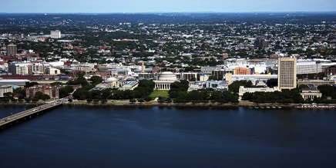
Kerberos: A Complex Solution to a Simple Password Problem
Week 5
Key Distribution
Center (KDC)
Alice
(Human)
Alice’s
PC (A)
Bob’s
Server (B)
LAN
LAN
Basic Kerberos Concept:
Invented at MIT in 1980’s as part of Project Athena
Goal is that Alice (client) can authenticate to Bob (server)
without using a password on the local area network (LAN);
Key Distribution Center (KDC) enables this process using
conventional cryptography (i.e., no public key technology)

Slide 38
Kerberos – Preconditions
Week 5
Infrastructure
Preconditions:
Key Distribution
Center (KDC)
Alice
(Human)
Alice’s
PC (A)
Bob’s
Server (B)
LAN
LAN
password
password
Kerberos password set up
for Alice to log into her PC
(Never used over any LAN)

Slide 39
Kerberos – Keys
Week 5
Infrastructure
Preconditions:
K_{KDC} : KDC’s Encryption
Key (Created by KDC)
Key Distribution
Center (KDC)
Alice
(Human)
Alice’s
PC (A)
Bob’s
Server (B)
LAN
LAN
password
password
Key (Issued by KDC)
K_{A} : Alice’s Encryption
K_{B} : Bob’s Encryption
Key (Issued by KDC)
Kerberos KDC creates and issues
three cryptographic keys: K_{A ,} K_{B ,} K_{KDC}
{ { m } _{KA} } _{KA} = m
{ { m } _{KB} } _{KB} = m
{ { m } _{KKDC} } _{KKDC} = m
Encrypt
Decrypt

Slide 40
Kerberos – Clocks
Week 5
LAN
LAN
Alice
A (Client)
KDC
B (Server)
password
password, K_{A}
K_{A} , K_{B} , K_{KDC}
K_{B}
Synchronized clocks
produce current time
t_{c} for A, KDC, and B
Alice (A) wants to login
to Bob (B) (server)

Slide 41
Kerberos Step 1: Type in Local Password
Week 5
LAN
LAN
Alice
A (Client)
KDC
B (Server)
password
password, K_{A} , t_{c}
K_{A} , K_{B} , K_{KDC} , t_{c}
K_{B} , t_{c}
Step 1: Alice types in
Kerberos password

Slide 42
Kerberos Step 2: Request TGT and Session Key
Week 5
LAN
LAN
Alice
A (Client)
KDC
B (Server)
password
password, K_{A} , t_{c}
K_{A} , K_{B} , K_{KDC} , t_{c}
K_{B} , t_{c}
Step 1: Alice types in
Kerberos password
Step 2: A makes request for a
Ticket-Generating-Ticket (TGT)

Slide 43
Kerberos Step 3: Create Session Key and TGT
Week 5
LAN
LAN
Alice
A (Client)
KDC
B (Server)
password
password, K_{A} , t_{c}
K_{A} , K_{B} , K_{KDC} , t_{c}
K_{B} , t_{c}
Step 1: Alice types in
Kerberos password
Step 2: A makes request for a
Ticket-Generating-Ticket (TGT)
Step 3: KDC performs the
following computations:
Create Session Key S_{A} for A
Create TGT = {S_{A} , A } K_{KDC}

Slide 44
Kerberos Step 4: Provide Session Key and TGT
Week 5
LAN
LAN
Alice
A (Client)
KDC
B (Server)
password
password, K_{A} , t_{c}
K_{A} , K_{B} , K_{KDC} , t_{c}
K_{B} , t_{c}
Step 1: Alice types in
Kerberos password
Step 2: A makes request for a
Ticket-Generating-Ticket (TGT)
Step 3: KDC performs the
following computations:
Create Session Key S_{A} for A
Create TGT = {S_{A} , A } K_{KDC}
Step 4: KDC sends session key S_{A}
and TGT to A, encrypted with K_{A}
{ S_{A}, TGT } K_{A}

Slide 45
Kerberos Step 5: Decrypt Session Key and Store TGT
Week 5
LAN
LAN
Alice
A (Client)
KDC
B (Server)
password
password, K_{A} , t_{c}
K_{A} , K_{B} , K_{KDC} , t_{c}
K_{B} , t_{c}
Step 1: Alice types in
Kerberos password
Step 2: A makes request for a
Ticket-Generating-Ticket (TGT)
Step 3: KDC performs the
following computations:
Create Session Key S_{A} for A
Create TGT = {S_{A} , A } K_{KDC}
Step 4: KDC sends session key S_{A}
and TGT to A, encrypted with K_{A}
{ S_{A}, TGT } K_{A}
Step 5: A performs the
following computations:
Decrypt received message
to get Session Key and TGT
{ { S_{A}, TGT } _{KA} } _{KA} = S_{A} , TGT

Slide 46
Kerberos – Through Five Steps: Eve Cannot Hack
Week 5
LAN
LAN
Alice
A (Client)
KDC
B (Server)
password
password, K_{A} , t_{c}
K_{A} , K_{B} , K_{KDC} , t_{c}
K_{B} , t_{c}
Step 1: Alice types in
Kerberos password
Step 2: A makes request for a
Ticket-Generating-Ticket (TGT)
Step 3: KDC performs the
following computations:
Create Session Key S_{A} for A
Create TGT = {S_{A} , A } K_{KDC}
Step 4: KDC sends session key S_{A}
and TGT to A, encrypted with K_{A}
{ S_{A}, TGT } K_{A}
Step 5: A performs the
following computations:
Decrypt received message
to get Session Key and TGT
Intercept
TGT: Useless for replay
{ S_{A}, TGT } _{KA} : Useless, cannot decrypt
{ { S_{A}, TGT } _{KA} } _{KA} = S_{A} , TGT
Eve

Slide 47
Kerberos – Result of Five Steps
Week 5
LAN
LAN
Alice
A (Client)
KDC
B (Server)
password
password, K_{A} , t_{c}
TGT, S_{A}
K_{A} , K_{B} , K_{KDC} , t_{c}
TGT, S_{A}
K_{B} , t_{c}
Five step process for KDC to
distribute TGT and S_{A} to A

Slide 48
Kerberos Step 6: Request Login to B
Week 5
LAN
LAN
Alice
A (Client)
KDC
B (Server)
password
password, K_{A} , t_{c}
TGT, S_{A}
K_{A} , K_{B} , K_{KDC} , t_{c}
TGT, S_{A}
K_{B} , t_{c}
Step 6: A makes request to connect to B,
Provides TGT and Authenticator { t_{c} } _{SA}

Slide 49
Kerberos Step 7: Create Session Key and Ticket to Bob
Week 5
LAN
LAN
Alice
A (Client)
KDC
B (Server)
password
password, K_{A} , t_{c}
TGT, S_{A}
K_{A} , K_{B} , K_{KDC} , t_{c}
TGT, S_{A}
K_{B} , t_{c}
Step 6: A makes request to connect to B,
Provides TGT and Authenticator { t_{c} } _{SA}
Step 7: KDC performs the
following computations:
Decrypt TGT to get S_{A}
Use S_{A} to decrypt authentication
and check time
Create Session Key S_{AB} for A
to use to communicate with B
Create Ticket-to-Bob (TBOB)
{ S_{AB}, A } _{KB}

Slide 50
Kerberos Step 8: Send Session Key and Ticket to Bob
Week 5
LAN
LAN
Alice
A (Client)
KDC
B (Server)
password
password, K_{A} , t_{c}
TGT, S_{A}
K_{A} , K_{B} , K_{KDC} , t_{c}
TGT, S_{A}
K_{B} , t_{c}
Step 6: A makes request to connect to B,
Provides TGT and Authenticator { t_{c} } _{SA}
Step 7: KDC performs the
following computations:
Decrypt TGT to get S_{A}
Use S_{A} to decrypt authentication
and check time
Create Session Key S_{AB} for A
to use to communicate with B
Create Ticket-to-Bob (TBOB)
{ S_{AB}, A } _{KB}
Step 8: KDC sends session key S_{AB}
and TBOB encrypted with S_{A}
{ S_{AB} , TBOB } _{SA}

Slide 51
Kerberos Step 9: Decrypt Session Key and Store Ticket to Bob
Week 5
LAN
LAN
Alice
A (Client)
KDC
B (Server)
password
password, K_{A} , t_{c}
TGT, S_{A}
K_{A} , K_{B} , K_{KDC} , t_{c}
TGT, S_{A}
K_{B} , t_{c}
Step 6: A makes request to connect to B,
Provides TGT and Authenticator { t_{c} } _{SA}
Step 7: KDC performs the
following computations:
Decrypt TGT to get S_{A}
Use S_{A} to decrypt authentication
and check time
Create Session Key S_{AB} for A
to use to communicate with B
Create Ticket-to-Bob (TBOB)
{ S_{AB}, A } _{KB}
Step 8: KDC sends session key S_{AB}
and TBOB encrypted with S_{A}
{ S_{AB} , TBOB } _{SA}
Step 9: A performs the
following computations:
Decrypt received message
to get Session Key and TBOB
{ { S_{AB}, TBOB } _{SA} } _{SA} = S_{AB} , TBOB

Slide 52
Kerberos – Through Nine Steps: Eve Cannot Hack
Week 5
LAN
LAN
Alice
A (Client)
KDC
B (Server)
password
password, K_{A} , t_{c}
TGT, S_{A}
K_{A} , K_{B} , K_{KDC} , t_{c}
TGT, S_{A}
K_{B} , t_{c}
Step 6: A makes request to connect to B,
Provides TGT and Authenticator { t_{c} } _{SA}
Step 7: KDC performs the
following computations:
Decrypt TGT to get S_{A}
Use S_{A} to decrypt authentication
and check time
Create Session Key S_{AB} for A
to use to communicate with B
Create Ticket-to-Bob (TBOB)
{ S_{AB}, A } _{KB}
Step 8: KDC sends session key S_{AB}
and TBOB encrypted with S_{A}
{ S_{AB} , TBOB } _{SA}
Step 9: A performs the
following computations:
Decrypt received message
to get Session Key and TBOB
Intercept
TGT: Useless for replay
Authenticator cannot be replayed
(time staleness)
{ S_{AB} , TBOB } _{SA} : Useless, cannot decrypt
{ { S_{AB}, TBOB } _{SA} } _{SA} = S_{AB} , TBOB
Eve

Slide 53
Kerberos – Result of Nine Steps
Week 5
LAN
LAN
Alice
A (Client)
KDC
B (Server)
password
password, K_{A} , t_{c}
TGT, S_{A} , S_{AB} , TBOB
K_{A} , K_{B} , K_{KDC} , t_{c}
TGT, S_{A} , S_{AB} , TBOB
K_{B} , t_{c}
Four step process for KDC to
distribute TBOB and S_{AB} to A

Slide 54
Kerberos Step 10: Send Bob the Ticket to Bob
Week 5
LAN
LAN
Alice
A (Client)
KDC
B (Server)
password
password, K_{A} , t_{c}
TGT, S_{A} , S_{AB} , TBOB
K_{A} , K_{B} , K_{KDC} , t_{c}
TGT, S_{A} , S_{AB} , TBOB
K_{B} , t_{c}
Step 10: A sends to B the Authenticator { t_{c} } _{SA}
and TBOB = { S_{AB}, A } _{KB}

Slide 55
Kerberos Step 11: Decrypt Ticket to Bob and Check Time
Week 5
LAN
LAN
Alice
A (Client)
KDC
B (Server)
password
password, K_{A} , t_{c}
TGT, S_{A} , S_{AB} , TBOB
K_{A} , K_{B} , K_{KDC} , t_{c}
TGT, S_{A} , S_{AB} , TBOB
K_{B} , t_{c}
Step 10: A sends to B the Authenticator { t_{c} } _{SA}
and TBOB = { S_{AB}, A } _{KB}
Step 11: B performs the
following computations:
Decrypt TBOB to get S_{AB}
Use S_{AB} to decrypt
authentication and
check time

Slide 56
Kerberos – Result of Eleven Steps
Week 5
LAN
LAN
Alice
A (Client)
KDC
B (Server)
password
password, K_{A} , t_{c}
TGT, S_{A} , S_{AB} , TBOB
K_{A} , K_{B} , K_{KDC} , t_{c}
TGT, S_{A} , S_{AB} , TBOB
K_{B} , t_{c}
S_{AB} , TBOB
Two step process (plus nonce messages) for A to use TBOB to get S_{AB} to B

Slide 57
Kerberos – Realms
Week 5
Step 2: Realm 1, KDC 1
Forwards Request to
Realm 2, KDC 2
Realm 1
Realm 2
KDC 1
KDC 2 aaaa
Step 4: Realm 2 KDC 2
Services Local Access
Request from Client B
to Local Server X
Step 3: Realm 2
KDC 2 Forwards
Access to Local
Server X
Step 1: Client A
Requests Access
to Remote
Server X from
Realm 1, KDC 1
Client A
Server X
Client B

